Slide 1
Introduction to ITIL
Introductory Lecture

Slide 2
What is ITIL
ITIL (IT Infrastructure Library) provides a framework of Best Practice guidance for IT Service Management.

Slide 3
Key Principles of IT Service Management
Service Strategy
Service Design
Service Transition
Service Operation
Continual Service Improvement.

Slide 4
Service Management
Lecture 1

Slide 5
Service
A service is a means of delivering value to customers by facilitating outcomes that customers want to achieve without the ownership of specific costs and risks.

Slide 6
Service
The outcomes that customers want to achieve are the reason why they purchase or use a service.
The value of the service to the customer is directly dependent on how well a service facilitates these outcomes.

Slide 7
Service Management
Service management enables a service provider to:
understand the services that they are providing from both a consumer and provider perspective;
ensure that the services really do facilitate the outcomes that their customers want to achieve;
understand the value of those services to their customers and hence their relative importance;
understand and manage all of the costs and risks associated with providing those services.

Slide 8
Service Management
Service management is a set of specialised organisational capabilities for providing value to customers in the form of services.
These 'specialised organisational capabilities' include:
the processes,
activities,
functions and
Roles

Slide 9
Service Management
ITIL provides this definition for the concept of service management:
A set of specialized organizational capabilities for providing value to customers in the form of services.
The definition provided for a service provider:
An organization supplying services to one or more internal or external customers.

Slide 10
IT Service Management
IT service management (ITSM):
The implementation and management of quality IT services that meet the needs of the business. IT service management is performed by IT service providers through an appropriate mix of people, process and information technology.
IT service provider:
A service provider that provides IT services to internal or external customers.

Slide 11
IT Service Provider Types
ITIL defines the three provider types:
Type I: Internal Service Provider
Type II: Shared Services Unit
Type III: External Service Provider

Slide 12
Processes and Functions
A process is a structured set of activities designed to accomplish a specific objective. A process takes one or more defined inputs and turns them into defined outputs.
The ITIL framework is based on processes.

Slide 13
Process Characteristics
Measurability
Specific Results
Customers/Stakeholders
Responds to a Trigger

Slide 14
Functions
A function is defined by ITIL as a team or group of people and the other resources or tools that are used to carry out a process or process activities.

Slide 15
Functions
ITIL provides a set of defined roles:
Group: A number of people who are performing similar activities.
Team
Departments
Division

Slide 16
Sources of Best Practices
The sources of service management best practices include the following:
Proprietary knowledge/internal experience
Standards/industry practices
Training and education/academic research

Slide 17
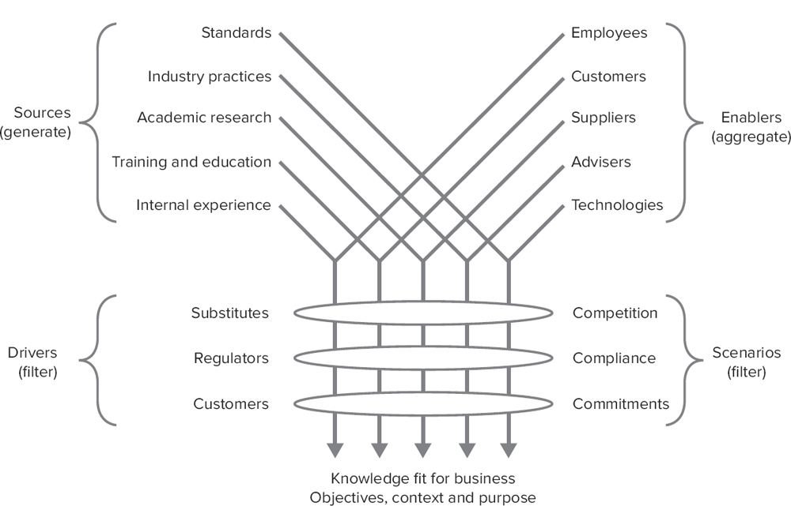
There are many sources of service management best practices.

Slide 18
IT Service
ITIL defines an IT service:
A service provided by an IT service provider.
An IT service is made up of a combination of information technology, people and processes.
A customer-facing IT service directly supports the business processes of one or more customers and its service level targets should be defined in a service level agreement.
Other IT services, called supporting services, are not directly used by the business but are required by the service provider to deliver customer-facing services.

Slide 19
Identifying Types of Service
Core Services
These are services that deliver the basic outcomes required by one or more customers.
They provide the value the customer wants and for which they are willing to pay.
Enabling Services
These are services that are needed to ensure that the core service can be delivered successfully.
These services may not be immediately visible to the customer and may not even be perceived as services in their own right.
Enhancing Services
These are additional services that enhance the core service, making it more attractive or appealing to the customer.
They are not essential to the delivery of the core services but are extra factors that make the offerings more attractive to the customer.

Slide 20
THE ITIL FRAMEWORK
ITIL is not a standard in the formal sense but a framework which is a source of good practice in service management.
The standard for IT service management (ITSM) is ISO/IEC 20000.

Slide 21
ITIL Framework
The ITIL has the following components:
ITIL Core: Publications describing generic best practice that is applicable to all types of organisation that provide services to a business.
ITIL Complementary Guidance: A set of publications with guidance specific to industry sectors, organisation types, operating models and technology architectures.

Slide 22
THE ITIL CORE
ITIL core represents the five ITIL service lifecycle publications.
The five core books cover each stage of the service lifecycle from:
Initial definition and analysis of business requirements in Service Strategy and Service Design,
through migration into the live environment within Service Transition,
to live operation and improvement in Service Operation and Continual Service Improvement

Slide 23
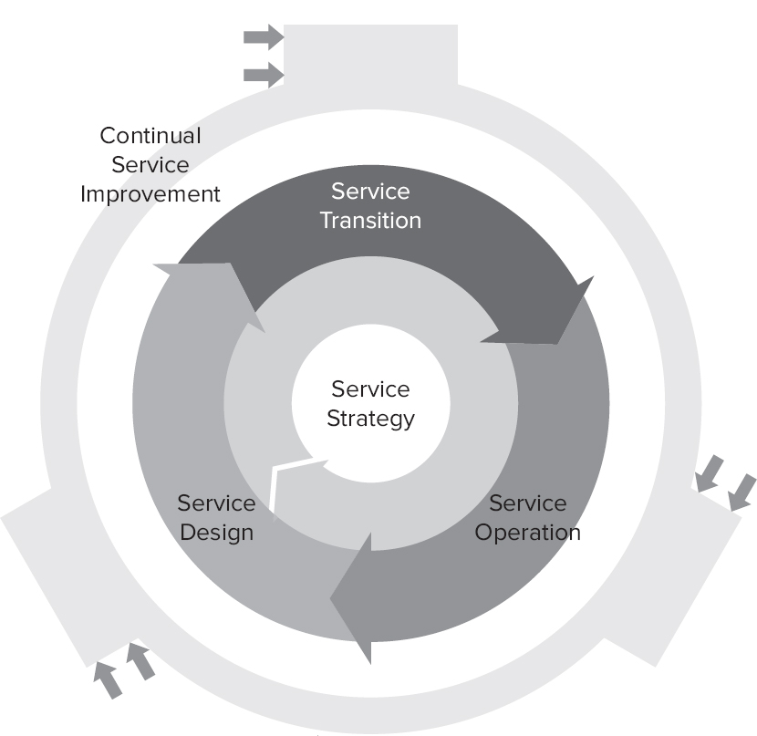
THE ITIL CORE

Slide 25
Quiz
Q1. Which of the following is not a recognized source of IT best practices according to ITIL?
Proprietary knowledge
Industry standards
Training
Auditors

Slide 26
Q2. Which of the following is a reason an organization might want to adopt ITIL best practices?
Advice on the technical specification of infrastructure
Advice on business strategy
Development of programming techniques
Management of IT services and budgetary controls

Slide 27
Q3.Which of the following is the correct description of a service?
Restores normal operations as soon as possible
Delivers value to customers, without ownership of specific costs and risks
Investigates the underlying cause of issues
Monitors targets according to contractual obligations
Q4.What is this? "The result of carrying out an activity, following a process, or delivering an IT service."
A procedure
A work instruction
An outcome
An input

Slide 28
Q5. What is an IT service made up of?
A combination of information technology, people, and processes
A combination of best practices, information technology, and outcomes
A combination of best practices, outcomes, and inputs
A combination of controls, outcomes, and inputs
Q6.Which of these is not a recognized type of service according to ITIL?
Core service
Supplier service
Enabling service
Enhancing service

Slide 29
Q7. Which of these statements is/are correct?
Internal services are delivered between departments or business units within the same organization.
External services are those delivered to an external customer.
1 only
2 only
Both
Neither
Q8.Which of these statements describes an IT service provider?
A third-party service provider delivering components of services
A business unit responsible for IT processes
A function that provides controls for IT infrastructure
A service provider that provides IT services to internal or external customers

Slide 30
Q9. How many service provider types does ITIL identify?
1
2
3
4
Q10. Which of these is not a characteristic of a process?
Delivers functions
Responds to a trigger
Delivers a specific result
Is measurable

Slide 31
Answers
Answers
1. D. Auditors are not a recognized source of best practice; they are an external body brought in to check something specific. The other three answers are all sources of best practice.
2. D. ITIL is a service management process framework concerned with planning, designing, transitioning, operating, and improving IT services within budget.
3. B. This is the ITIL definition of a service; all services should deliver value to the customer. A is the definition of incident management, C is an activity of problem management, and D is an activity of supplier management.
4. C. This is the ITIL definition of an outcome, the result of doing something.
5. A. This is the ITIL definition of the makeup of an IT service: the combination of processes (strategic, design, transition, operations, and improvement), the underlying infrastructure and applications the service is dependent on, and the roles required to support the service through the lifecycle.
6. B. There is no "supplier service" type identified. If services are provided by external parties, they would be either core, enabling, or enhancing.
7. C. Both of these statements are correct.
8. D. This is the ITIL definition for an IT service provider, providing IT services to customers.
9. C. There are three types of IT service provider: Type I internally embedded within a business unit, Type II internally shared between business units, and Type III external.
10. A. Functions are self-contained units of an organization with their own resources and capabilities to support an organization. Processes deliver value and define roles for the activities and decisions within that process.

